Slide 1
SECURITY IN AN ICE-FREE ARCTIC
“We need to take into account the diverse meanings different actors attach to ‘security’ in the Arctic.”
DR INGRID MEDBY
SENIOR LECTURER, OXFORD BROOKES UNIVERSITY
Hear more from Dr Medby at the BISA Virtual Roundtable: “Security in an ice-free Arctic: interdisciplinary perspectives on Arctic geopolitics” on 9 July, 2020 (2PM-3.30PM). Hosted by BISA War Studies Working Group

Slide 2
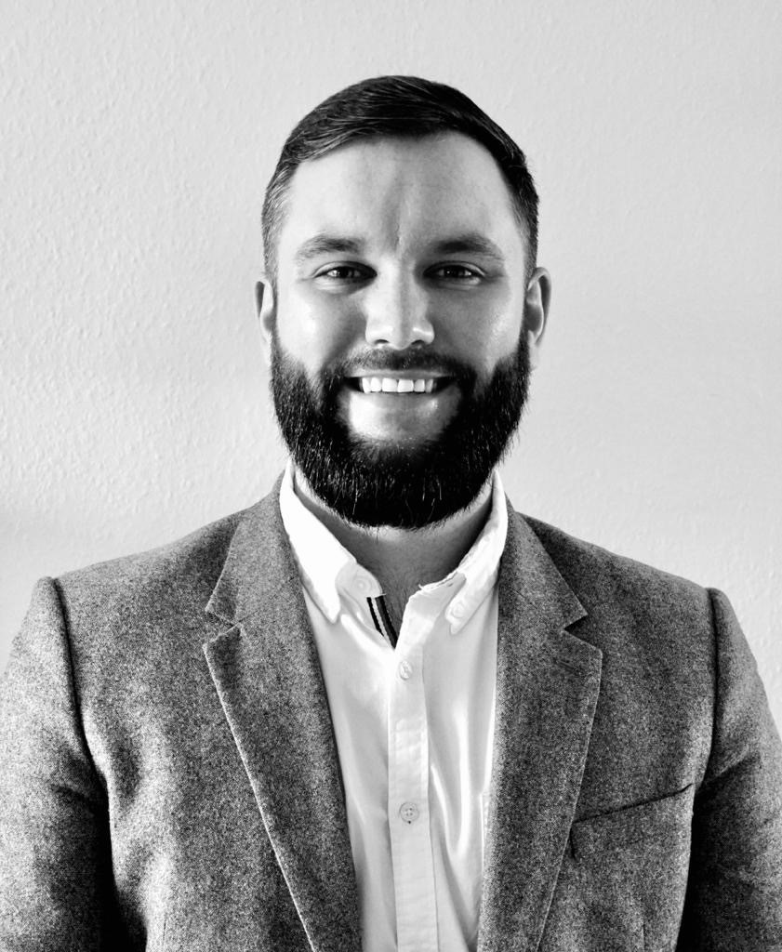
SECURITY IN AN ICE-FREE ARCTIC
“We are entering a delicate stage of Great Power balancing and remilitarisation in the Arctic”
DR JAMES ROGERS
ASSISTANT PROFESSOR, UNIVERSITY OF SOUTHERN DENMARK
Hear more from Dr Rogers at the BISA Virtual Roundtable: “Security in an ice-free Arctic: interdisciplinary perspectives on Arctic geopolitics” on 9 July, 2020 (2PM-3.30PM). Hosted by BISA War Studies Working Group

Slide 3
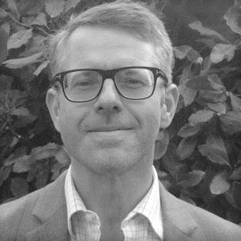
SECURITY IN AN ICE-FREE ARCTIC
“If the Arctic is no longer ‘reliably frozen’, then what implications follow for geopolitics and governance.”
PROFESSOR KLAUS DODDS
ROYAL HOLLOWAY, UNIVERSITY OF LONDON
Hear more from Professor Dodds at the BISA Virtual Roundtable: “Security in an ice-free Arctic: interdisciplinary perspectives on Arctic geopolitics” on 9 July, 2020 (2PM-3.30PM). Hosted by BISA War Studies Working Group

Slide 4
SECURITY IN AN ICE-FREE ARCTIC
“What we need is a new approach from the Social Sciences to understanding the Arctic”
PROFESSOR CAROLINE KENNEDY-PIPE
LOUGHBOROUGH UNIVERSITY
Hear more from Professor Kennedy-Pipe at the BISA Virtual Roundtable: “Security in an ice-free Arctic: interdisciplinary perspectives on Arctic geopolitics” on 9 July, 2020 (2PM-3.30PM). Hosted by BISA War Studies Working Group

Slide 5
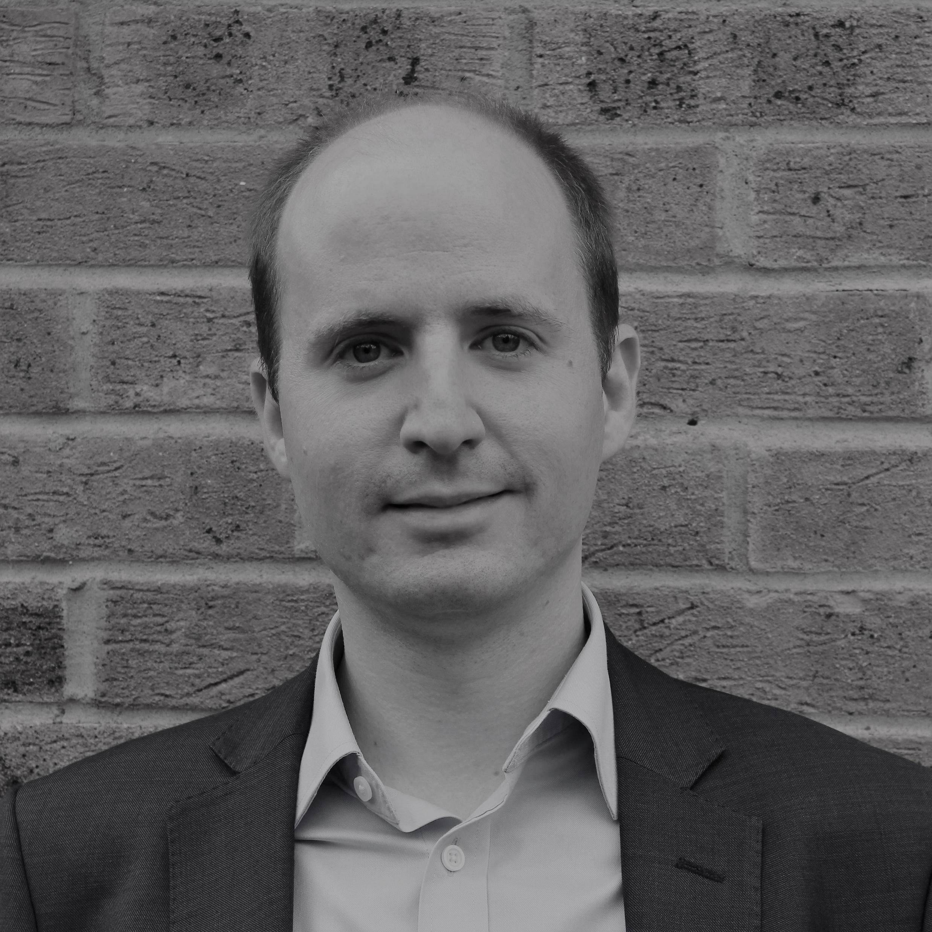
SECURITY IN AN ICE-FREE ARCTIC
“As the international community tries to come to terms with the possibility of an ‘ice-free’ Arctic, tensions are starting to build”.
DR DUNCAN DEPLEDGE
LECTURER, LOUGHBOROUGH UNIVERSITY
Crop pictures to 13.86cm (h) x 12.44cm (w)
Hear more from Dr Depledge at the BISA Virtual Roundtable: “Security in an ice-free Arctic: interdisciplinary perspectives on Arctic geopolitics” on 9 July, 2020 (2PM-3.30PM). Hosted by BISA War Studies Working Group

